Slide 1
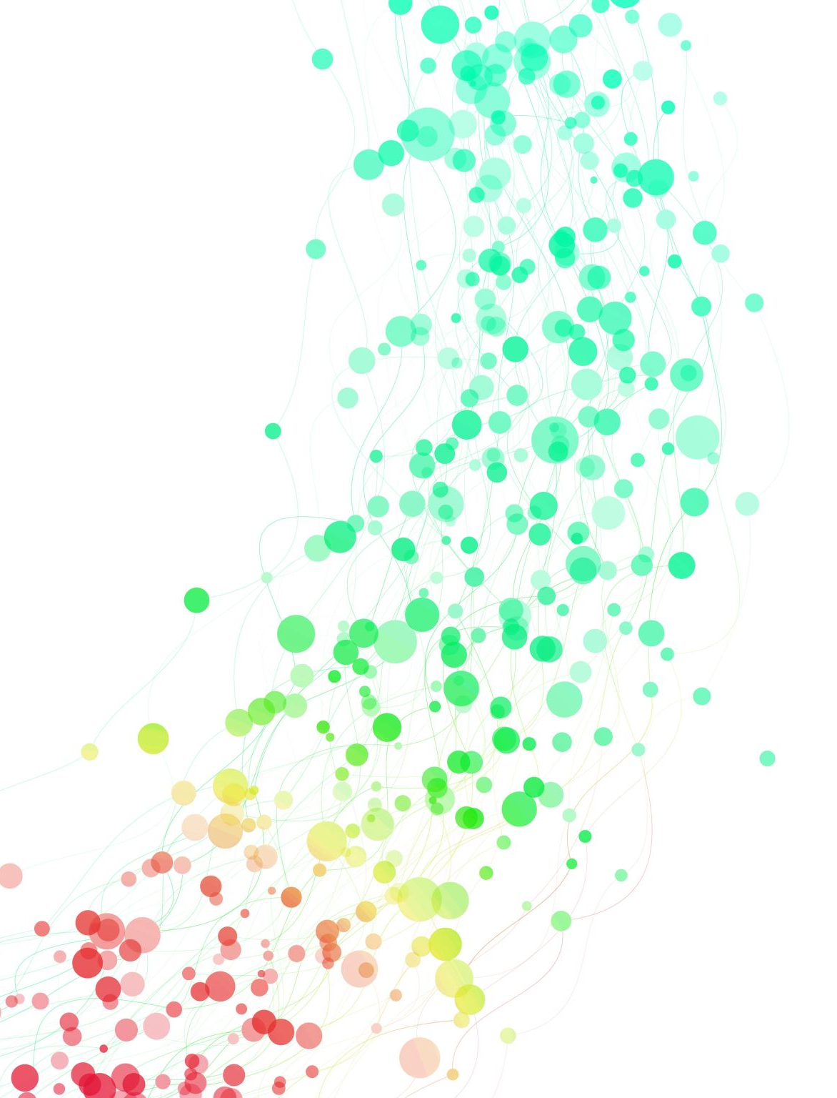
Home Loan Analysis

Slide 3
Table of Contents
Introduction
Objective
Used Libraries
Dataset
Analysis
Conclusion
References

Slide 4
Introduction
The Company produces a huge amount of data.
This data is not always made use to the full extent and is often underutilized.
Using this huge amount of data, approval of the loan can be predicted.
We try to concentrate on Home Loan prediction.
Using machine learning techniques, the home loan can be predicted.
The Loan data such as Gender, Marital Status, Education, Number of Dependents, Income, Loan Amount, Credit History and so on is taken as input and then these features are modeled for prediction.

Slide 5
Abstract:
We are creating a Data Analysis Project on Home Loan. Customer first apply for home loan after that company validates the customer eligibility for loan.
The Company wants to automate the loan eligibility process (real time) based on customer detail provided while filling online application form. These details are Gender, Marital Status, Education, Number of Dependents, Income, Loan Amount, Credit History and others. To automate this process, they have given a problem to identify the customers segments, those are eligible for loan amount so that they can specifically target these customers.
It’s a classification problem , given information about the application we have to predict whether the they’ll be to pay the loan or not.
We’ll start by exploratory data analysis , then preprocessing , and finally we’ll be testing different models such as Logistic regression, SVM, Random forest and Neural Network.

Slide 6
Objective:
To determine the status of the loan.
To answer the complex queries for Home loan.
To help the company to make intelligent financial decisions with the help of our analysis.

Slide 7
Used Libraries:
pandas
numpy
matplotlib.pyplot
seaborn

Slide 8
Dataset
Downloaded dataset Home Loan https://github.com/Gianatmaja/Customer-Segmentation-on-Home-Loans/blob/main/Train_Loan_Home.csv.
Saved the downloaded dataset in the working directory with the name Train_Loan_Home.csv

Slide 9
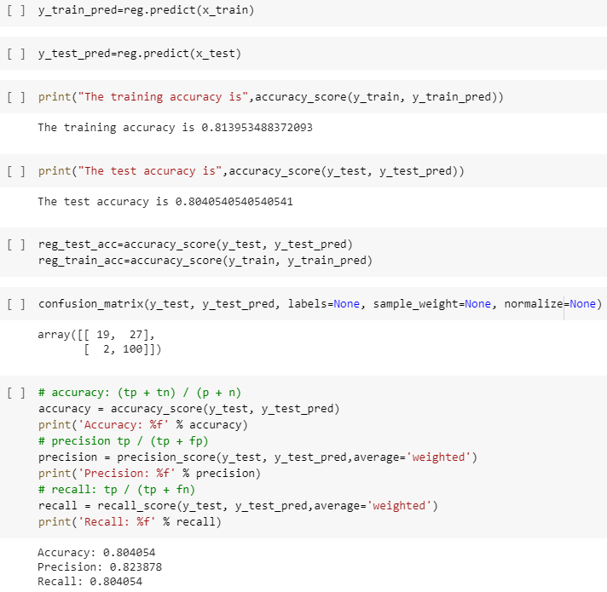
logistic Regression

Slide 10
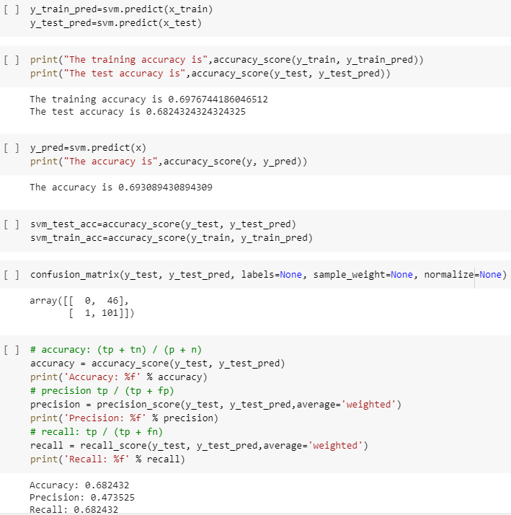
SVM

Slide 11
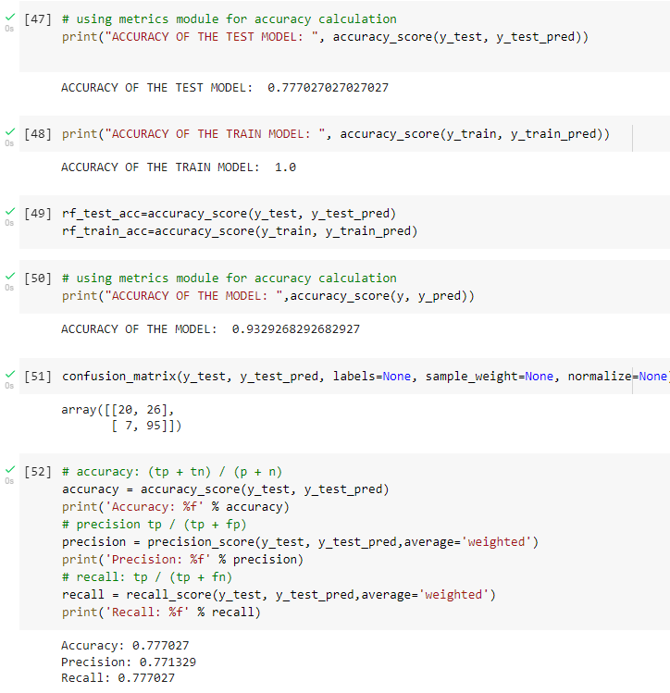
Random Forest

Slide 12
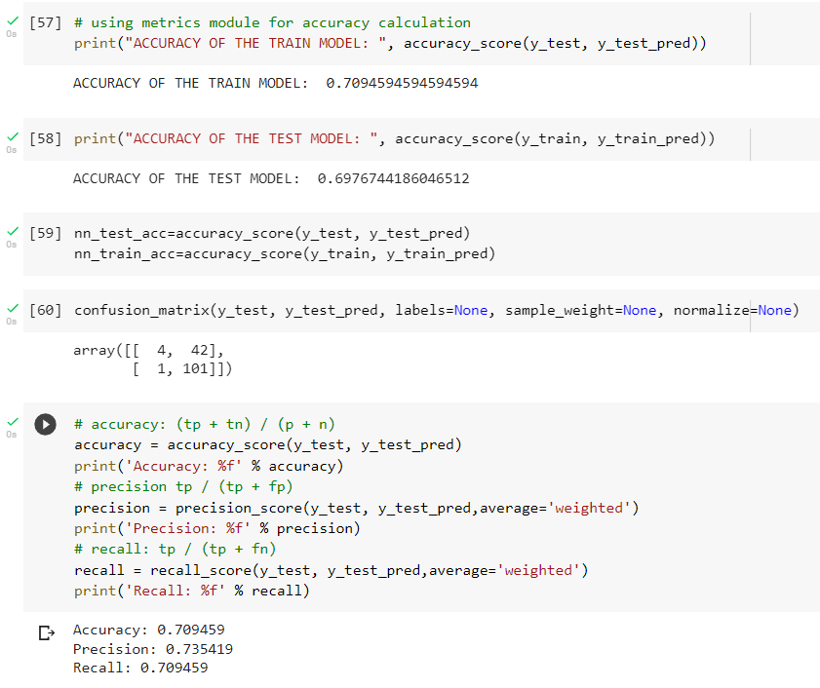
Neural Network

Slide 13
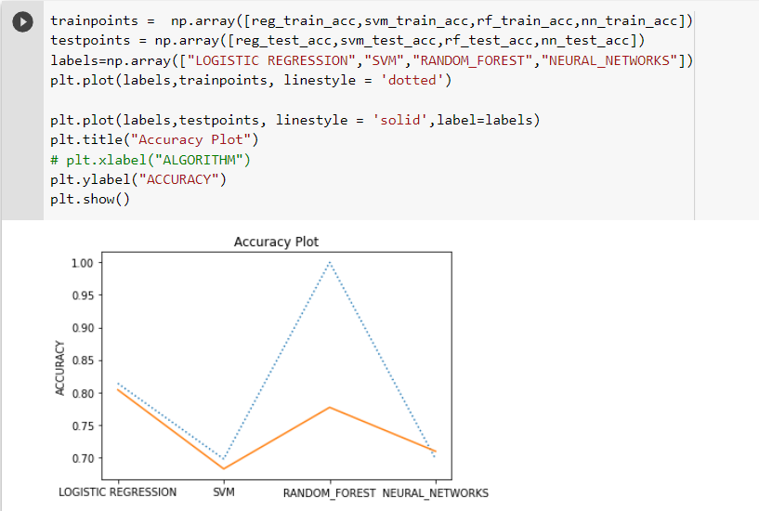
Accuracy Plot

Slide 14
Conclusion
this project Home Loan analysis is extremely much useful in everyone’s day to day life and it's mainly more important for the Banking sector.
They are the one that daily uses these systems to predict the loan approval of the Customer.
The distributions of the Gender, Marital Status, Education, Number of Dependents, Income, Loan Amount, Credit History and others, target is analysed, and the conclusion is drawn.
The conclusion which we found is that this project performed better in this analysis.

Slide 15
References
https://github.com/Gianatmaja/Customer-Segmentation-on-Home-Loans/blob/main/Train_Loan_Home.csv

Slide 16

Thank you

